Slide 1
Results PET MR Age

Slide 2
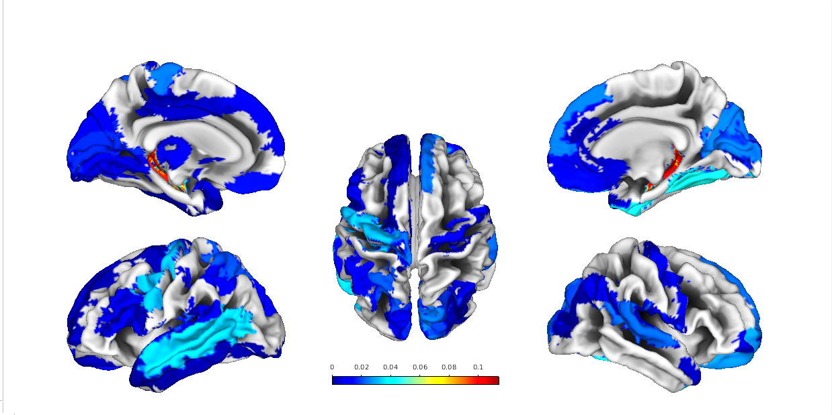
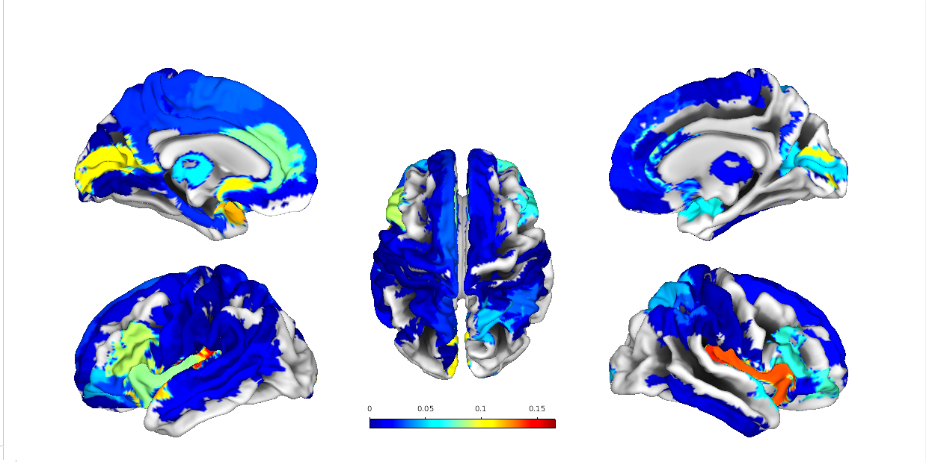
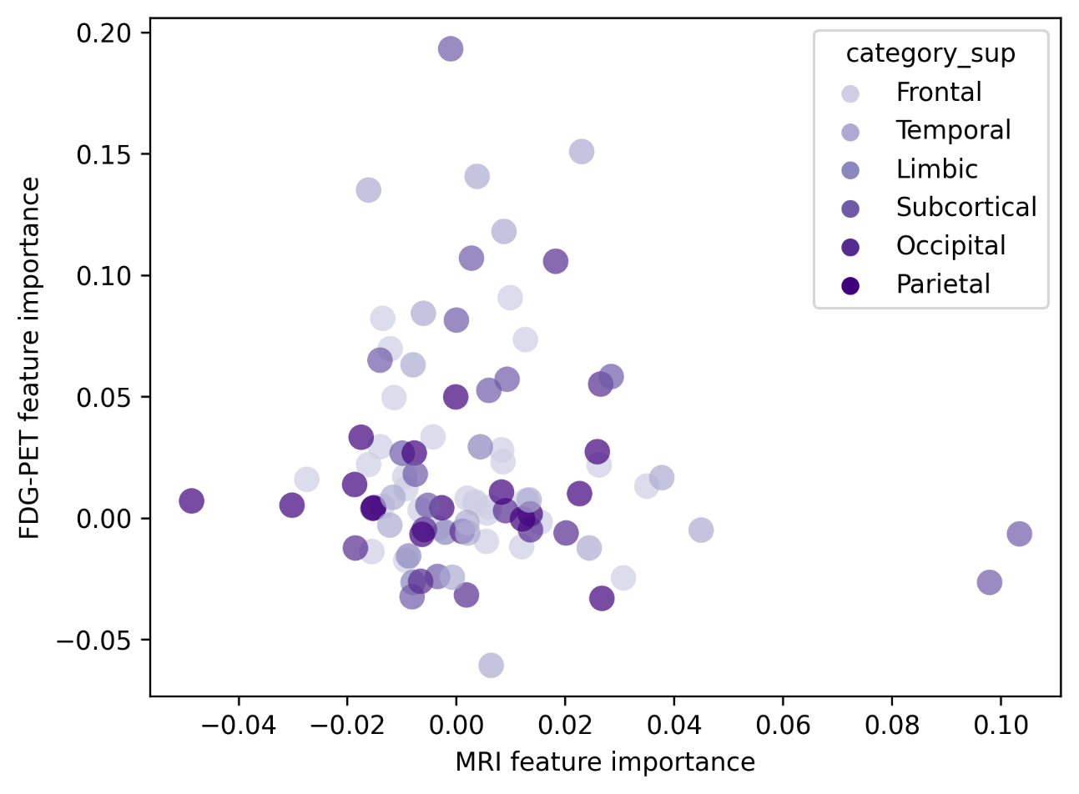
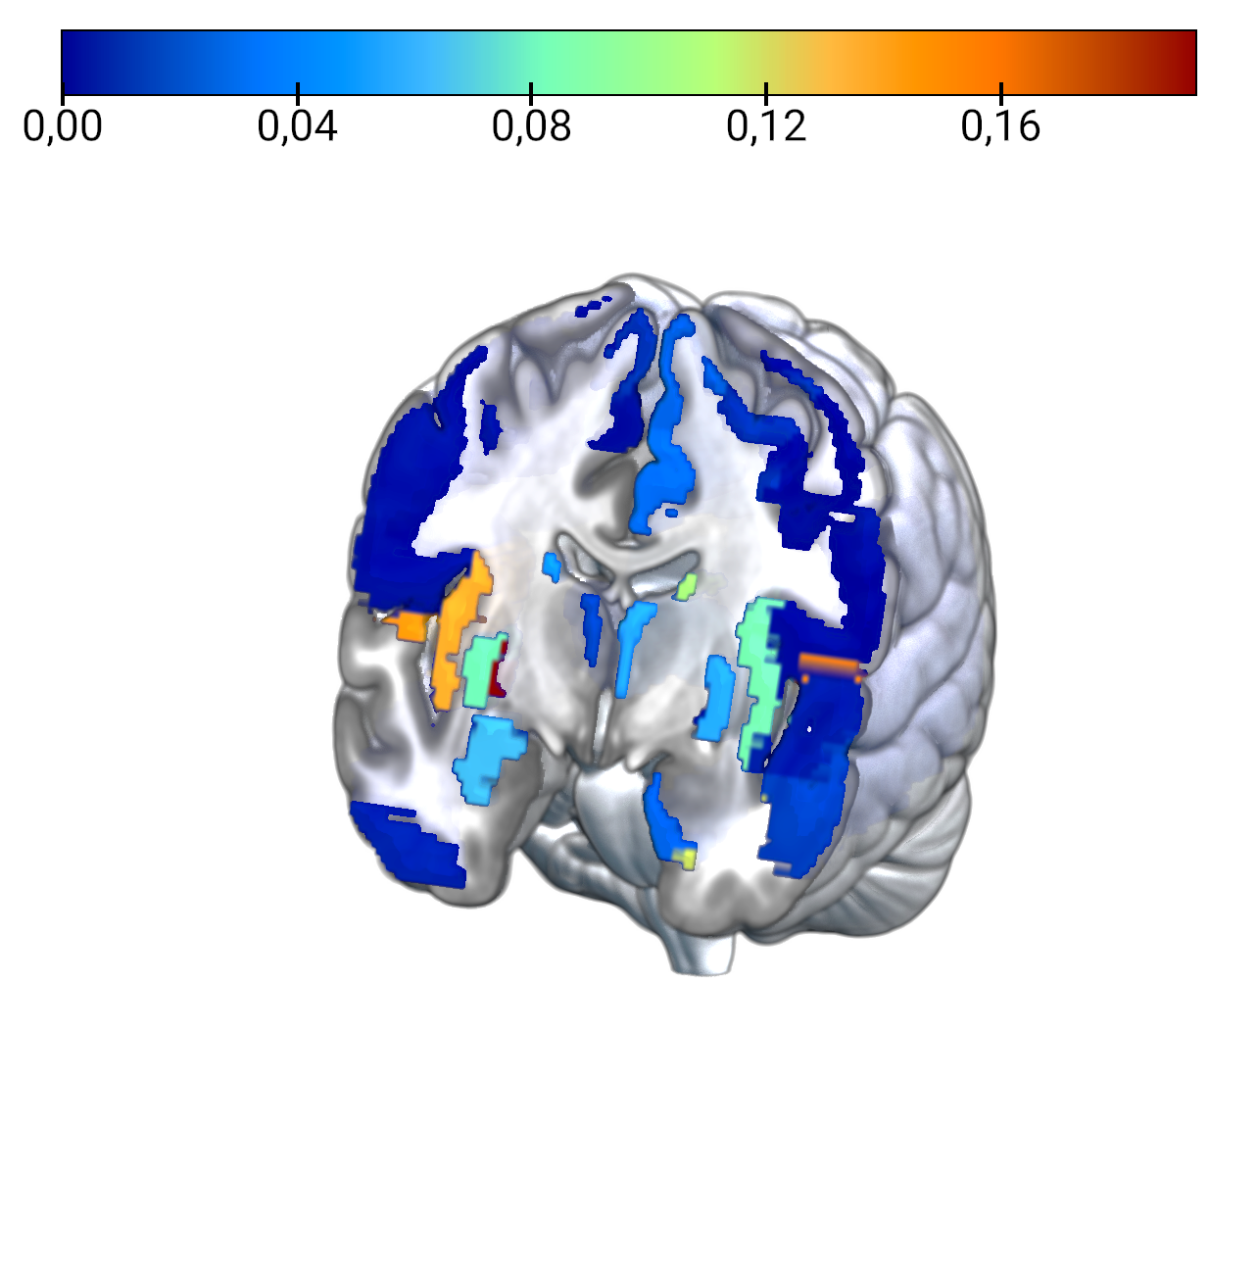
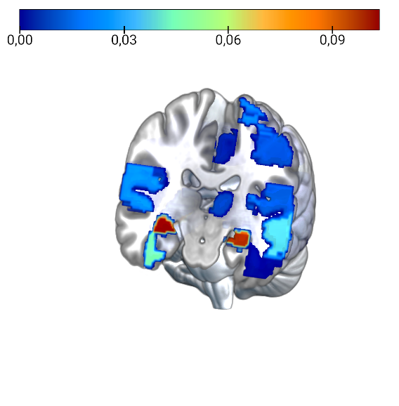
Feature Importance
MRI most important:
Hippocampus_R 0.103435 SC
Hippocampus_L 0.097946 SC
Fusiform_R 0.044986 T
Temporal_Mid_L 0.037761 T
Precentral_L 0.034999 F
Frontal_Sup_Orb_R 0.030697 F
Putamen_L 0.028467 SC
Cuneus_R 0.026757 Par
Temporal, frontal and subcortical
PET most important:
Glob pallidus_R 0.193169 SC
Heschl_L 0.150865 T
Heschl_R 0.140645 T
Insula_R 0.135028 T
Temporal_Pole_Sup_L 0.117953 T
Caudate_L 0.106961 SC
Calcarine_L 0.105684 OC
Temporal and subcortical
Notes:
GP: MR-based age-related effects on the striatum, globus pallidus, and thalamus in healthy individuals across the adult lifespan

Slide 3
CN

Slide 4
Correlations
SUMMARYSUVR_WHOLECEREBNORM
FDG-PET BAG
n r CI95% p-val
spearman 148 0.010911 [-0.15, 0.17] 0.896732
MRI BAG:
n r CI95% p-val
spearman 148 -0.00295 [-0.17, 0.16] 0.972006
ABETA42_recalculated
FDG-PET BAG
n r CI95% p-val
spearman 133 -0.10999 [-0.28, 0.06] 0.214659
MRI BAG:
n r CI95% p-val
spearman 133 0.003742 [-0.17, 0.18] 0.966431
TAU
FDG-PET BAG
n r CI95% p-val
spearman 133 0.030792 [-0.14, 0.2] 0.729038
MRI BAG:
n r CI95% p-val
spearman 133 0.067567 [-0.11, 0.24] 0.446771
PTAU
FDG-PET BAG
n r CI95% p-val
spearman 132 0.027696 [-0.15, 0.2] 0.756307
MRI BAG:
n r CI95% p-val
spearman 132 0.096077 [-0.08, 0.27] 0.280666
PTAU.ABETA42
FDG-PET BAG
n r CI95% p-val
spearman 132 0.140656 [-0.03, 0.31] 0.113281
MRI BAG:
n r CI95% p-val
spearman 132 0.028804 [-0.15, 0.2] 0.746884
ADNI_EF
FDG-PET BAG
n r CI95% p-val
pearson 154 0.100538 [-0.06, 0.26] 0.220902
MRI BAG:
n r CI95% p-val
pearson 154 0.016362 [-0.14, 0.18] 0.842471
ADNI_MEM
FDG-PET BAG
n r CI95% p-val
pearson 154 0.095433 [-0.07, 0.25] 0.245361
MRI BAG:
n r CI95% p-val
pearson 154 -0.00149 [-0.16, 0.16] 0.985563

Slide 5
Cognitive Decline
FDG-PET BAG:
Source SS DF F p-unc np2
0 DX.cat.n 0.264328 1 0.022995 0.879676 0.000154
1 PTEDUCAT 2.322164 1 0.202013 0.653754 0.001354
2 APOE4 2.083316 1 0.181235 0.670928 0.001215
3 PTGENDER 9.784358 1 0.851176 0.357711 0.005680
4 Residual 1712.770207 149 NaN NaN NaN
MRI BAG:
Source SS DF F p-unc np2
0 DX.cat.n 5.907111 1 0.616708 0.433520 0.004122
1 PTEDUCAT 11.308085 1 1.180575 0.278994 0.007861
2 APOE4 7.125908 1 0.743952 0.389784 0.004968
3 PTGENDER 112.687111 1 11.764645 0.000781 0.073179
Residual 1427.189635 149 NaN NaN NaN
Mean PET BAG stables: [0.12122472], mean PET BAG decliners: [-0.09121563].
Mean MRI BAG stables: [0.02527369], mean MRI BAG decliners: [0.7636731].

Slide 6
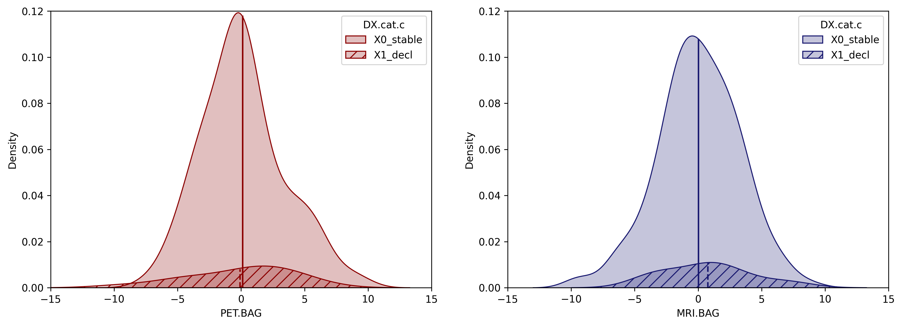

Slide 7
SCD

Slide 8
Correlations
SUMMARYSUVR_WHOLECEREBNORM
FDG-PET BAG
n r CI95% p-val
spearman 82 0.190656 [-0.03, 0.4] 0.094522
MRI BAG:
n r CI95% p-val
spearman 82 0.013653 [-0.21, 0.24] 0.905565
ABETA42_recalculated
FDG-PET BAG
n r CI95% p-val
pearson 77 -0.161349 [-0.38, 0.07] 0.172655
MRI BAG:
n r CI95% p-val
pearson 77 -0.238304 [-0.44, -0.01] 0.042328
TAU
FDG-PET BAG
n r CI95% p-val
spearman 77 -0.155753 [-0.37, 0.08] 0.18823
MRI BAG:
n r CI95% p-val
spearman 77 -0.258662 [-0.46, -0.03] 0.027132
PTAU
FDG-PET BAG
n r CI95% p-val
spearman 77 -0.165186 [-0.38, 0.07] 0.162532
MRI BAG:
n r CI95% p-val
spearman 77 -0.262292 [-0.46, -0.03] 0.024977
PTAU.ABETA42
FDG-PET BAG
n r CI95% p-val
spearman 77 0.087179 [-0.15, 0.31] 0.463316
MRI BAG:
n r CI95% p-val
spearman 77 0.016899 [-0.21, 0.25] 0.887157
ADNI_EF
FDG-PET BAG
n r CI95% p-val
pearson 83 -0.190052 [-0.39, 0.03] 0.093421
MRI BAG:
n r CI95% p-val
pearson 83 0.047778 [-0.18, 0.27] 0.675854
ADNI_MEM
FDG-PET BAG
n r CI95% p-val
pearson 83 -0.25925 [-0.45, -0.04] 0.021048
MRI BAG:
n r CI95% p-val
pearson 83 -0.131784 [-0.34, 0.09] 0.246983

Slide 9
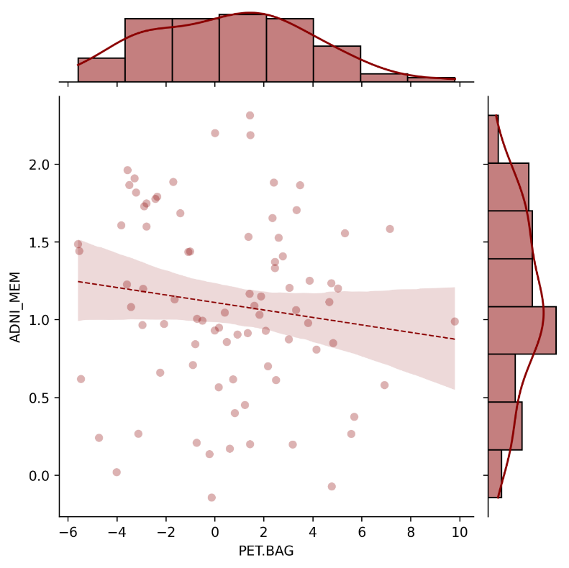
Cognitive Performance
The negative correlation between FDG-PET BAG and memory performance could suggest that FDG-PET BAG is sensitive to very early memory decline that may already be felt by participants. This is also evident from the trend significant advanced FDG-PET BAG (not observed on MRI) in SCD compared to CN as well as, although not significant, the higher BAG in decliners compared to stables.
ADNI-MEM
FDG-PET BAG [years]

Slide 10
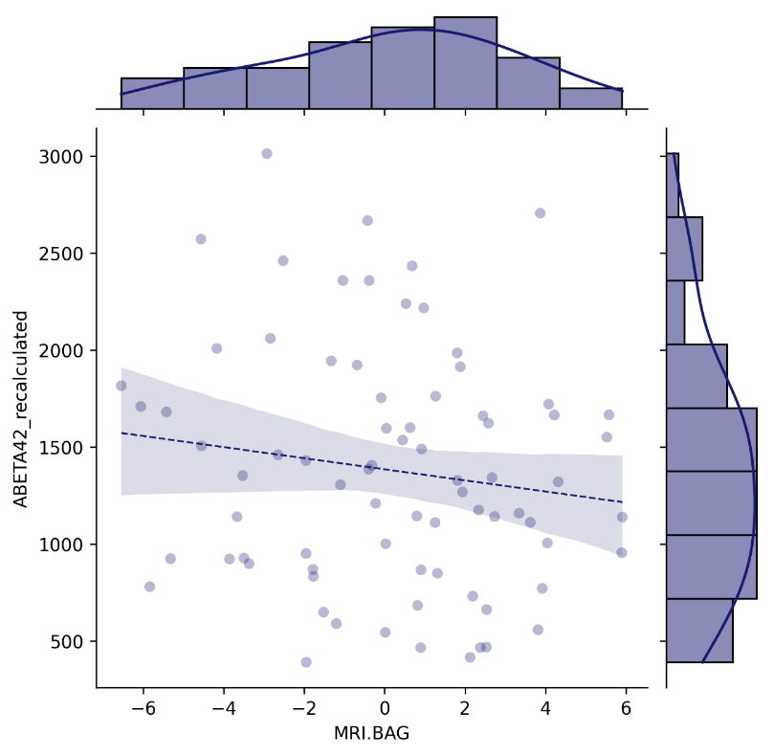
Neuropathology
CSF Aβ₁₋₄₂ [pg/ml]
MRI BAG [years]

Slide 11
Cognitive Decline
FDG-PET BAG:
Source SS DF F p-unc np2
0 DX.cat.n 17.154630 1 1.655094 0.202072 0.020778
1 PTEDUCAT 36.891986 1 3.559371 0.062932 0.043641
2 APOE4 0.483006 1 0.046601 0.829651 0.000597
3 PTGENDER 2.148206 1 0.207261 0.650188 0.002650
Residual 808.450371 78 NaN NaN NaN
MRI BAG:
Source SS DF F p-unc np2
0 DX.cat.n 2.213411 1 0.247204 0.620449 0.003159
1 PTEDUCAT 3.034701 1 0.338930 0.562126 0.004326
2 APOE4 0.929472 1 0.103808 0.748169 0.001329
3 PTGENDER 54.052781 1 6.036876 0.016230 0.071836
Residual 698.393853 78 NaN NaN NaN
Mean FDG-PET BAG stables: [0.44264944], mean FDG-PET BAG decliners: [1.77055891].
Mean MRI BAG stables: [-0.00479381], mean MRI BAG decliners: [0.95311537].

Slide 12
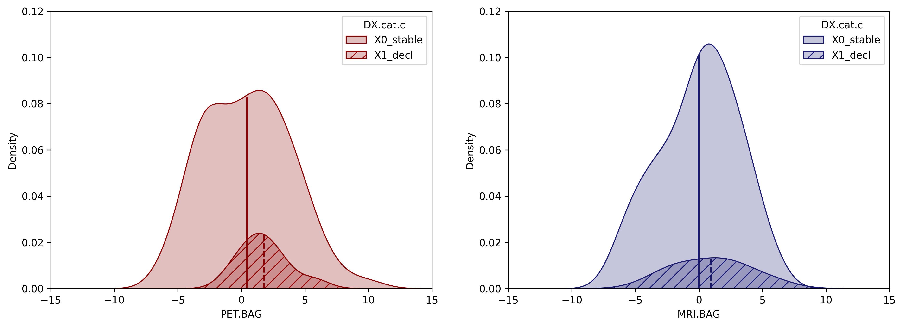
Category
Category
Stable
Decline
Stable
Decline
Density
Density
FDG-PET BAG [years]
MRI BAG [years]

Slide 13
CU

Slide 14
Correlations
SUMMARYSUVR_WHOLECEREBNORM
FDG-PET BAG
n r CI95% p-val
spearman 230 0.061144 [-0.07, 0.19] 0.360211
MRI BAG:
n r CI95% p-val
spearman 230 0.004653 [-0.13, 0.14] 0.944545
ABETA42_recalculated
FDG-PET BAG
n r CI95% p-val
spearman 210 -0.144092 [-0.28, -0.01] 0.038798
MRI BAG:
n r CI95% p-val
spearman 210 -0.075456 [-0.21, 0.06] 0.281061
TAU
FDG-PET BAG
n r CI95% p-val
spearman 210 -0.041969 [-0.18, 0.1] 0.549195
MRI BAG:
n r CI95% p-val
spearman 210 -0.065518 [-0.2, 0.07] 0.349459
PTAU
FDG-PET BAG
n r CI95% p-val
spearman 209 -0.048816 [-0.18, 0.09] 0.487005
MRI BAG:
n r CI95% p-val
spearman 209 -0.055656 [-0.19, 0.08] 0.428001
PTAU.ABETA42
FDG-PET BAG
n r CI95% p-val
spearman 209 0.11616 [-0.02, 0.25] 0.097195
MRI BAG:
n r CI95% p-val
spearman 209 0.019165 [-0.12, 0.16] 0.785052
ADNI_EF
FDG-PET BAG
n r CI95% p-val
pearson 237 -0.019401 [-0.15, 0.11] 0.768312
MRI BAG:
n r CI95% p-val
pearson 237 0.022626 [-0.11, 0.15] 0.731185
ADNI_MEM
FDG-PET BAG
n r CI95% p-val
pearson 237 -0.015334 [-0.14, 0.11] 0.815902
MRI BAG:
n r CI95% p-val
pearson 237 -0.04841 [-0.18, 0.08] 0.462096

Slide 15
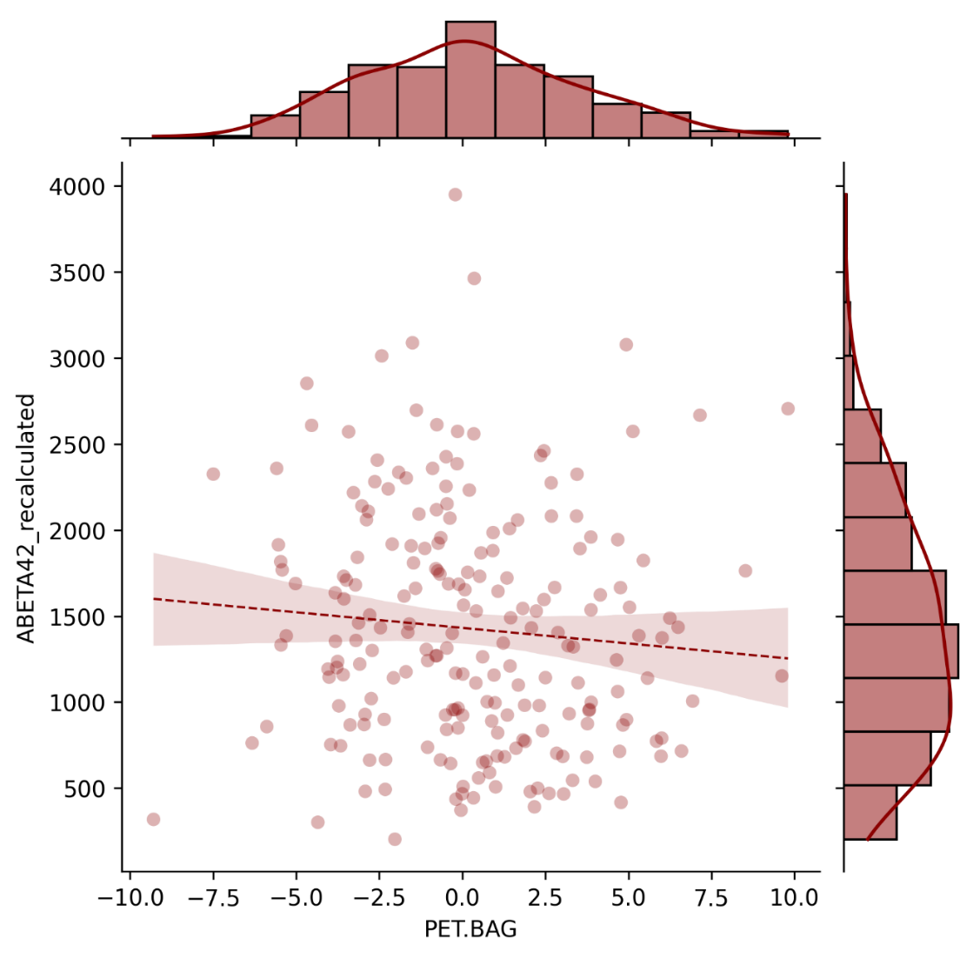
Pathology
CSF Aβ₁₋₄₂ [pg/ml]
FDG-PET BAG [years]

Slide 16
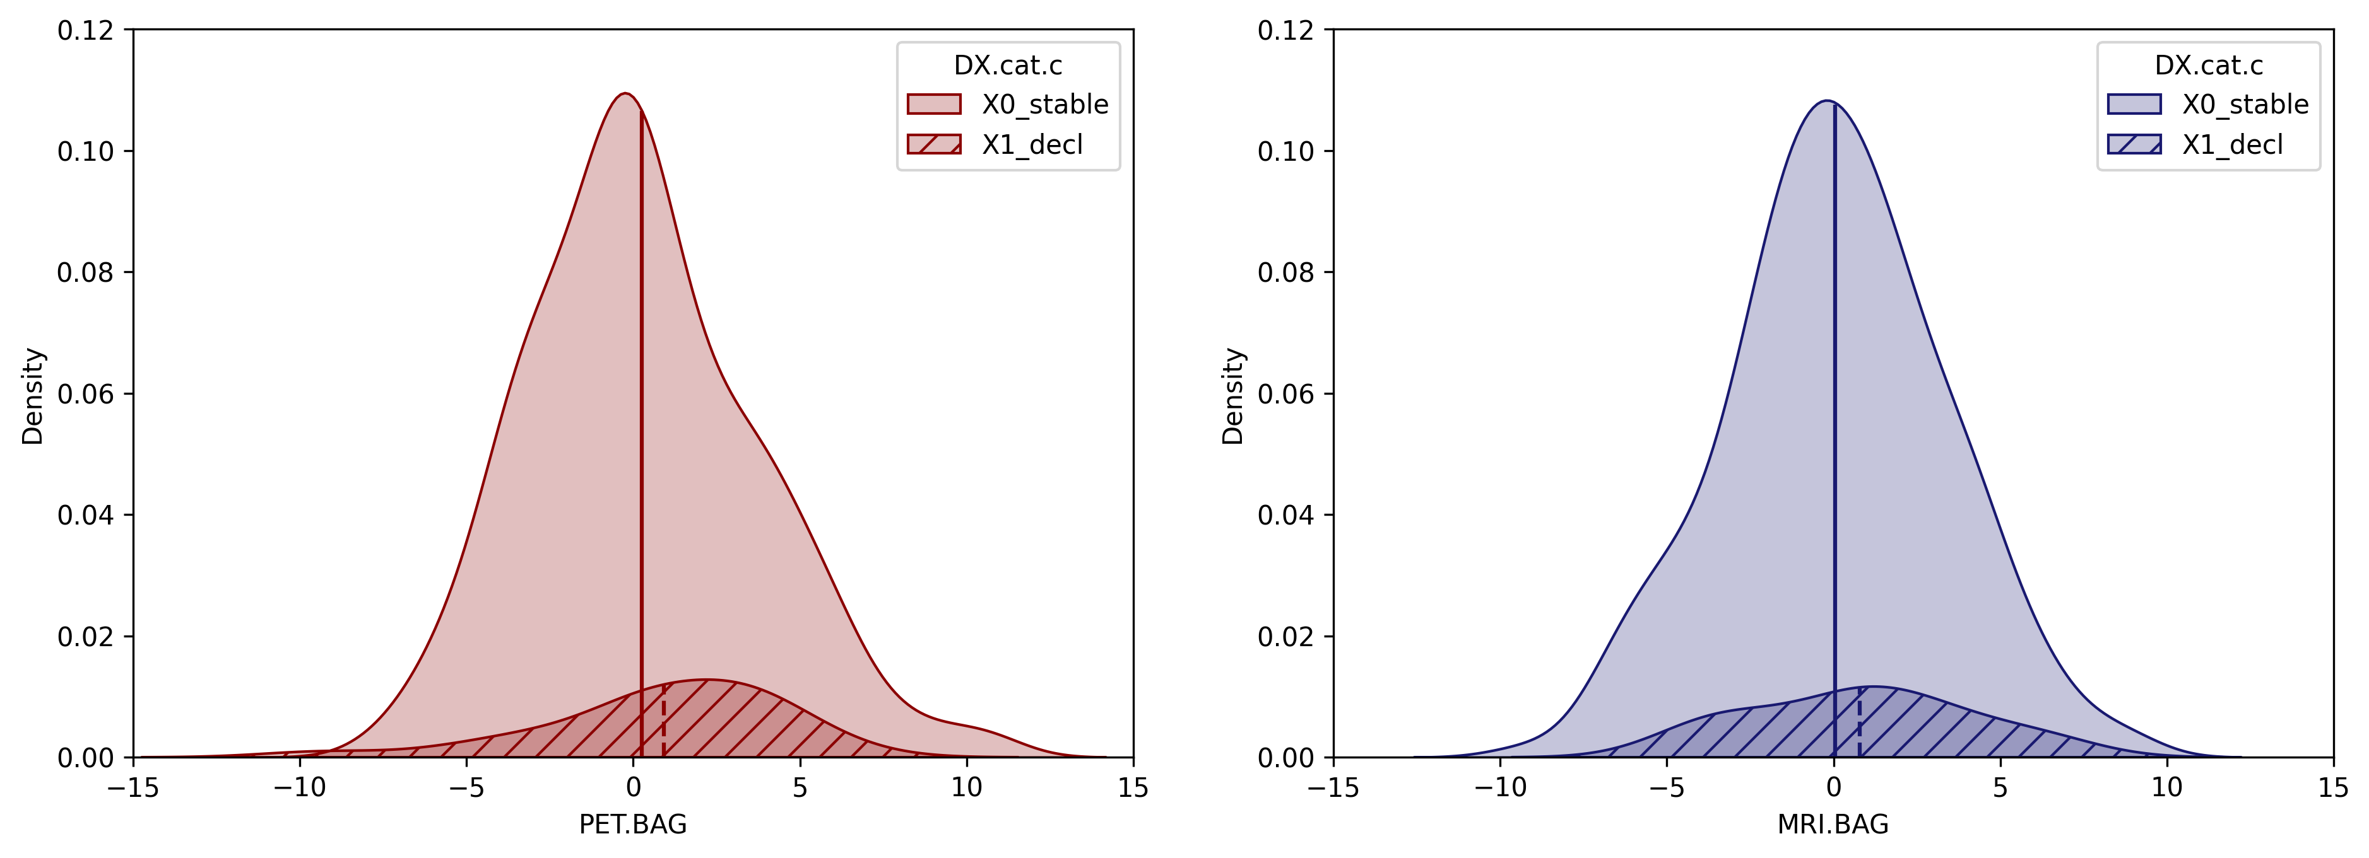
Category
Category
Stable
Decline
Stable
Decline
Density
Density
FDG-PET BAG [years]
MRI BAG [years]

Slide 17
Cognitive Outcome
PET.BAG
237 subjects with full information.
AUC: 0.6305555555555555
MRI.BAG
237 subjects with full information.
AUC: 0.5564935064935066
Hippocampus_GMV
237 subjects with full information.
AUC: 0.7373737373737373
SUMMARYSUVR_WHOLECEREBNORM
230 subjects with full information.
AUC: 0.5454761904761904
Precuneus_SUVR
237 subjects with full information.
AUC: 0.5762626262626263
PTAU.ABETA42
209 subjects with full information.
AUC: 0.6052631578947368
ADNI_MEM
237 subjects with full information.
AUC: 0.7696969696969698
meanage
237 subjects with full information.
AUC: 0.6384199134199134
FDG-PET BAG: Source SS DF F p-unc np2
0 DX.cat.n 6.837289 1 0.619197 0.432149 0.002662
1 PTEDUCAT 23.887457 1 2.163292 0.142697 0.009238
2 APOE4 1.361825 1 0.123329 0.725770 0.000531
3 PTGENDER 16.879719 1 1.528658 0.217564 0.006546
4 Residual 2561.785948 232 NaN NaN NaN
MRI BAG: Source SS DF F p-unc np2
0 DX.cat.n 8.060314 1 0.870007 0.351923 0.003736
1 PTEDUCAT 2.160633 1 0.233212 0.629607 0.001004
2 APOE4 1.332777 1 0.143856 0.704824 0.000620
3 PTGENDER 175.282953 1 18.919538 0.000020 0.075401
4 Residual 2149.399517 232 NaN NaN NaN
Mean PET BAG stables: [0.23242853], mean PET BAG decliners: [0.6248515].
Mean MRI BAG stables: [0.01487119], mean MRI BAG decliners: [0.83653551].

Slide 18
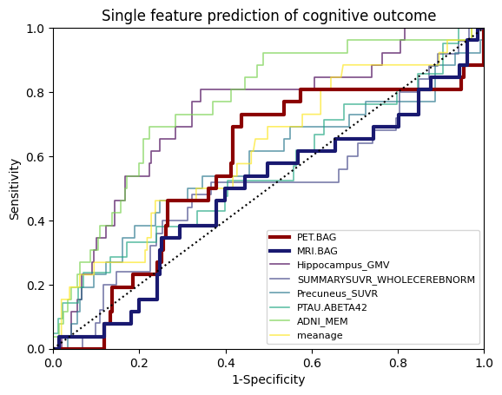
Sensitivity
FDG-PET BAG
MRI BAG
Hippocampus GMV
AV45-PET
Precuneus SUVR
p-tau₁₈₁/Aβ₁₋₄₂ ratio
ADNI-MEM
age
1-Specificity

Slide 19
MCI

Slide 20
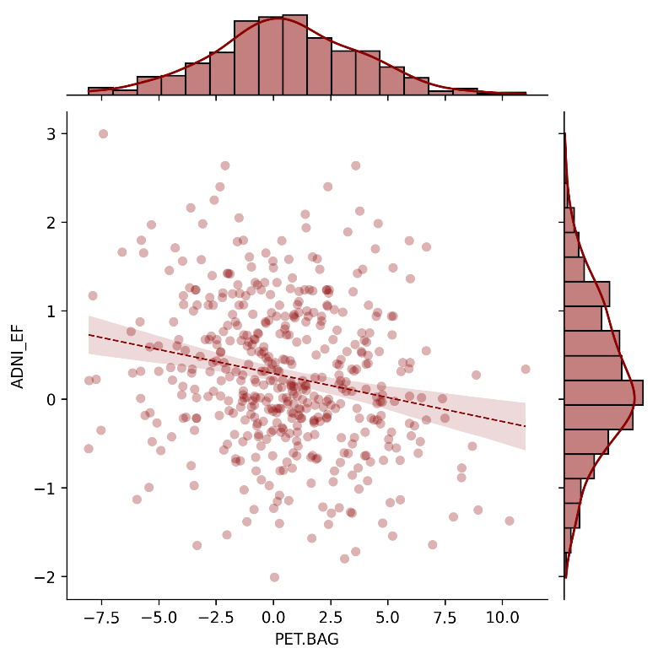
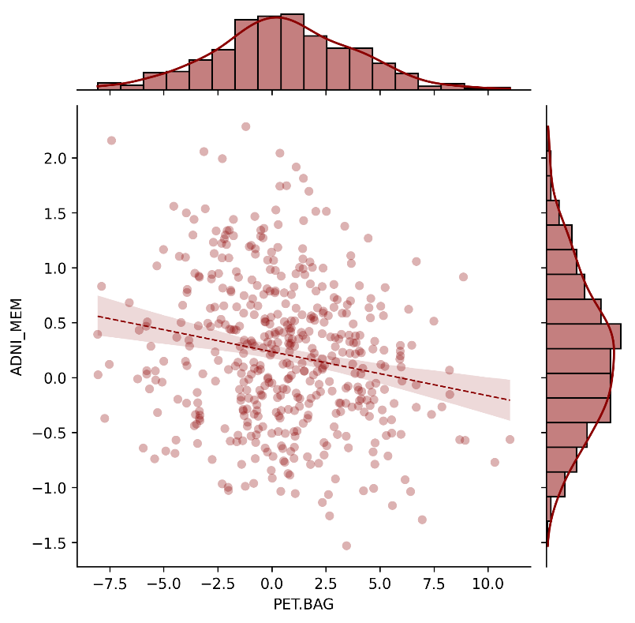
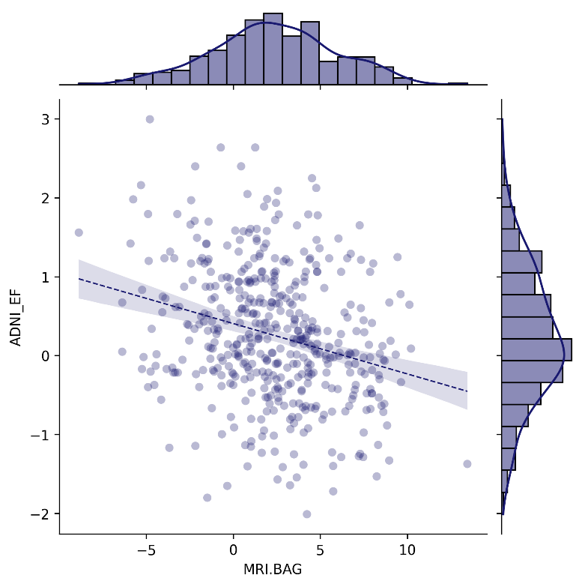
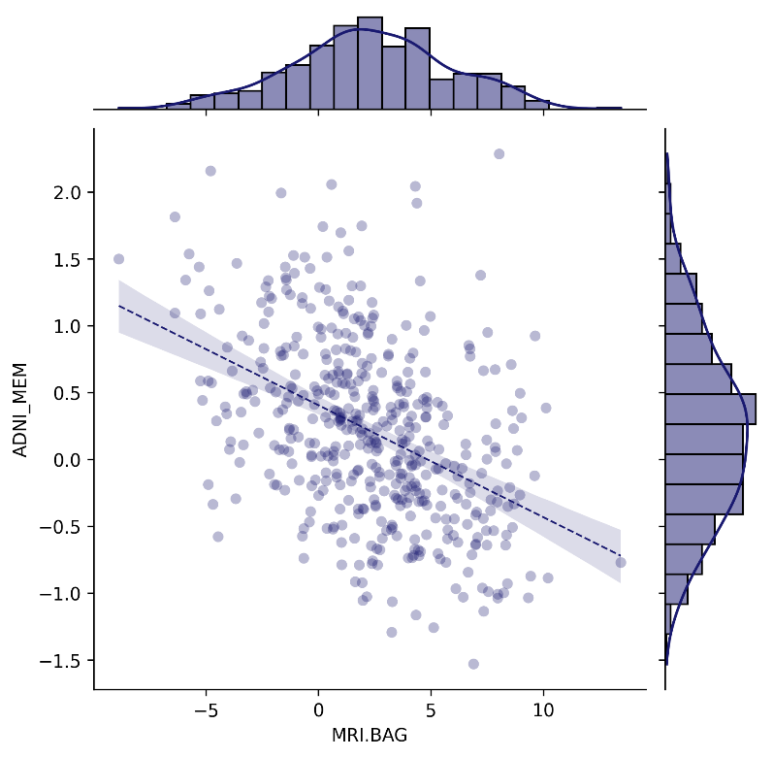
Cognitive Performance
r = -.238, p < .001
r = -.179, p < .001
ADNI-EF
ADNI-MEM
ADNI-MEM
ADNI_EF
FDG-PET BAG
n r CI95% p-val
pearson 460 -0.237727 [-0.32, -0.15] 2.801281e-07
MRI BAG:
n r CI95% p-val
pearson 460 -0.225374 [-0.31, -0.14] 0.000001
ADNI_MEM
FDG-PET BAG
n r CI95% p-val
spearman 460 -0.179125 [-0.27, -0.09] 0.00012
MRI BAG:
n r CI95% p-val
spearman 460 -0.397101 [-0.47, -0.32] 1.126132e-18
FDG-PET BAG [years]
FDG-PET BAG [years]
r = -.225, p < .001
r = -.397, p < .001
ADNI-EF
ADNI-MEM
MRI BAG [years]
MRI BAG [years]

Slide 21
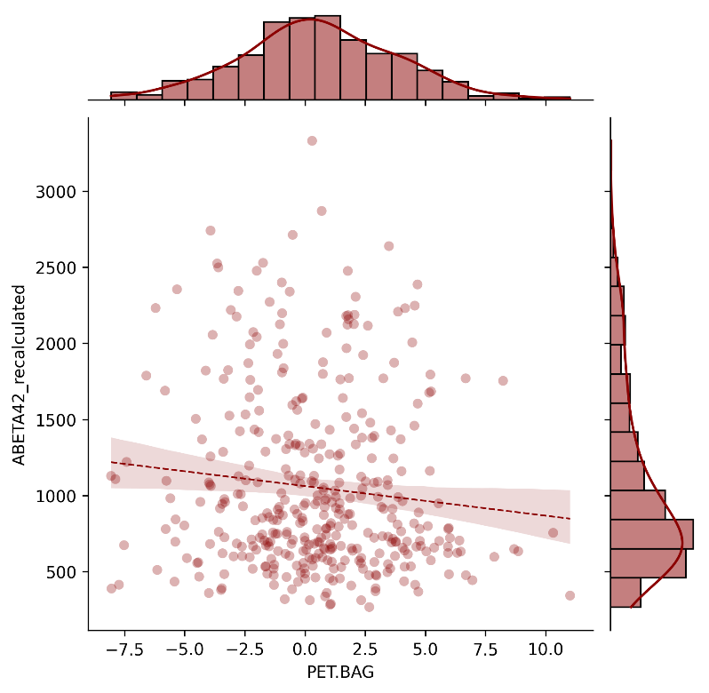
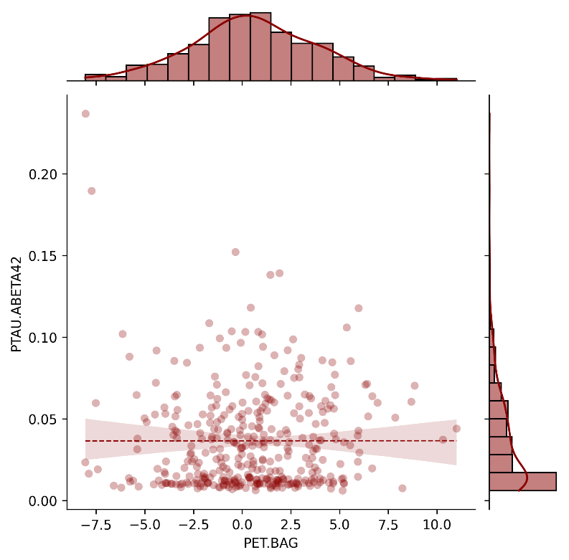
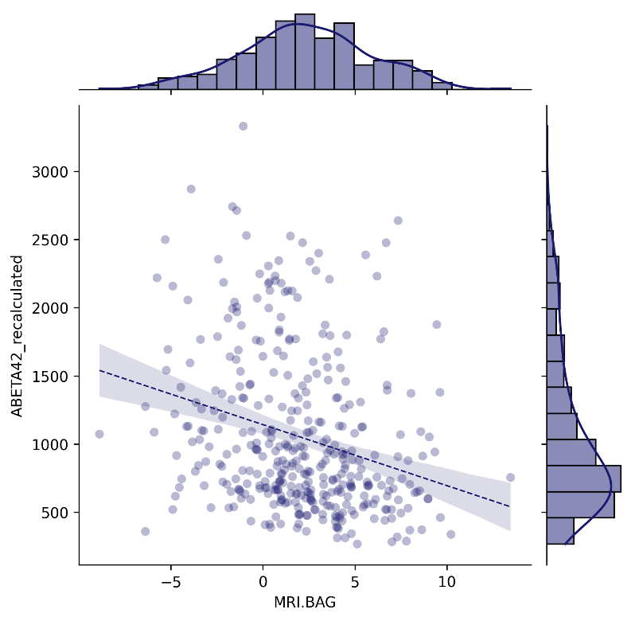
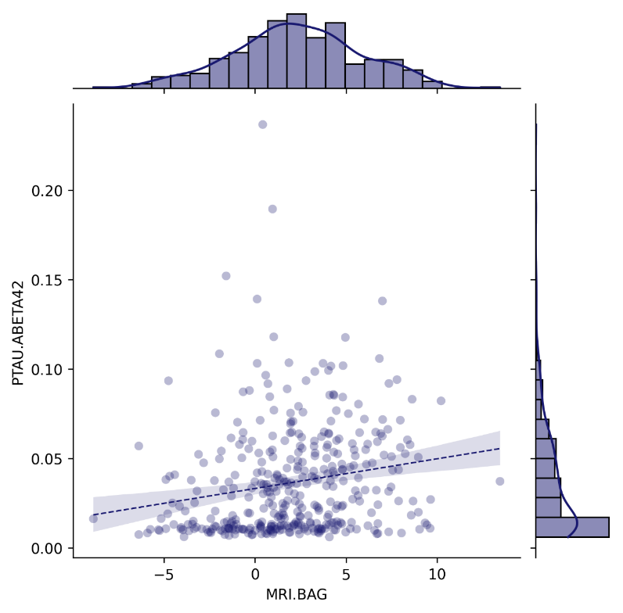
Pathology
rho = -.126, p = .015
rho = .100, p = .052
SUMMARYSUVR_WHOLECEREBNORM
FDG-PET BAG
n r CI95% p-val
spearman 326 0.056035 [-0.05, 0.16] 0.316159
MRI BAG:
n r CI95% p-val
spearman 326 0.095495 [-0.01, 0.2] 0.08711
ABETA42_recalculated
FDG-PET BAG
n r CI95% p-val
spearman 376 -0.12584 [-0.22, -0.02] 0.015157
MRI BAG:
n r CI95% p-val
spearman 376 -0.230316 [-0.32, -0.13] 0.000007
TAU
FDG-PET BAG
n r CI95% p-val
spearman 376 0.00831 [-0.09, 0.11] 0.87309
MRI BAG:
n r CI95% p-val
spearman 376 0.047291 [-0.05, 0.15] 0.363057
PTAU
FDG-PET BAG
n r CI95% p-val
spearman 376 0.009136 [-0.09, 0.11] 0.860591
MRI BAG:
n r CI95% p-val
spearman 376 0.055329 [-0.05, 0.16] 0.287158
PTAU.ABETA42
FDG-PET BAG
n r CI95% p-val
spearman 376 0.100708 [-0.0, 0.2] 0.052285
MRI BAG:
n r CI95% p-val
spearman 376 0.200282 [0.1, 0.3] 0.000101
CSF Aβ₁₋₄₂ [pg/ml]
p-Tau₁₈₁/CSF Aβ₁₋₄₂ ratio
FDG-PET BAG [years]
FDG-PET BAG [years]
rho = -.230, p < .001
rho = .200, p < .001
CSF Aβ₁₋₄₂ [pg/ml]
p-Tau₁₈₁/CSF Aβ₁₋₄₂ ratio
MRI BAG [years]
MRI BAG [years]

Slide 22
FDG-PET BAG:
Source SS DF F p-unc np2
0 DX.cat.n 95.843181 1 9.346308 0.002366 0.020128
1 PTEDUCAT 1.202126 1 0.117227 0.732219 0.000258
2 APOE4 4.202522 1 0.409816 0.522385 0.000900
3 PTGENDER 39.643049 1 3.865858 0.049886 0.008425
4 Residual 4665.868761 455 NaN NaN NaN
MRI BAG:
Source SS DF F p-unc np2
0 DX.cat.n 657.402966 1 66.034264 4.221225e-15 0.126737
1 PTEDUCAT 0.499288 1 0.050152 8.228994e-01 0.000110
2 APOE4 0.486270 1 0.048844 8.251856e-01 0.000107
3 PTGENDER 347.291806 1 34.884477 6.856291e-09 0.071210
4 Residual 4529.744589 455 NaN NaN NaN
Mean FDG-PET BAG stables: [0.30563297], mean FDG-PET BAG decliners: [1.3491923].
Mean MRI BAG stables: [1.58252294], mean MRI BAG decliners: [4.50295814].

Slide 23
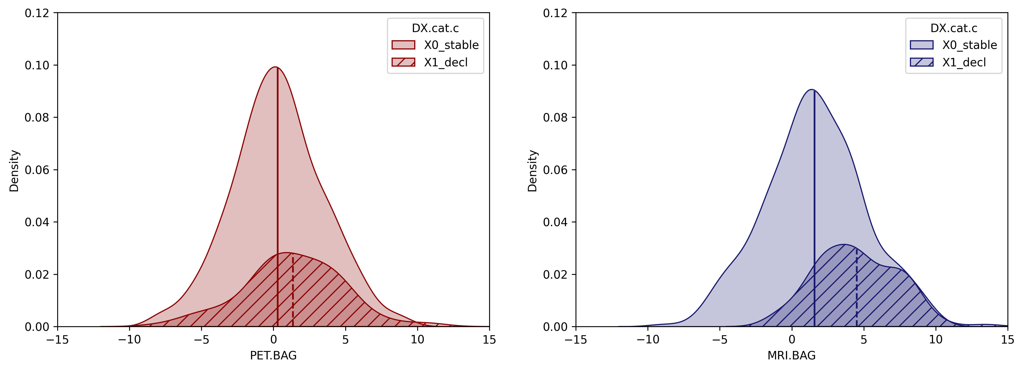
p = .002
Category
p < .001
Category
Stable
Decline
Stable
Decline
Density
Density
FDG-PET BAG [years]
MRI BAG [years]
Notes:
R ANCOVA results pending

Slide 24
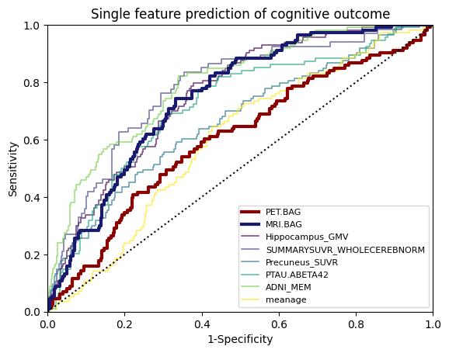
PET.BAG
460 subjects with full information.
AUC: 0.6058651642475171, Sensitivity: nan, Specificity: nan
10 folds did not contain any positive class predictions.
MRI.BAG
460 subjects with full information.
AUC: 0.7504469060351414, Sensitivity: 0.7075757575757576, Specificity: 0.6805042016806724
0 folds did not contain any positive class predictions.
Hippocampus_GMV
460 subjects with full information.
AUC: 0.7588286223580342, Sensitivity: 0.6727272727272726, Specificity: 0.688655462184874
0 folds did not contain any positive class predictions.
SUMMARYSUVR_WHOLECEREBNORM
326 subjects with full information.
AUC: 0.7859267399267399, Sensitivity: 0.6928571428571428, Specificity: 0.7335384615384616
0 folds did not contain any positive class predictions.
Precuneus_SUVR
460 subjects with full information.
AUC: 0.6707620320855614, Sensitivity: 0.5984848484848485, Specificity: 0.584593837535014
4 folds did not contain any positive class predictions.
PTAU.ABETA42
376 subjects with full information.
AUC: 0.7263095238095237, Sensitivity: 0.5777777777777777, Specificity: 0.7448275862068965
0 folds did not contain any positive class predictions.
ADNI_MEM
460 subjects with full information.
AUC: 0.7968270944741532, Sensitivity: 0.7113636363636363, Specificity: 0.7006722689075631
0 folds did not contain any positive class predictions.
meanage
460 subjects with full information.
AUC: 0.6065234275528393, Sensitivity: nan, Specificity: nan
10 folds did not contain any positive class predictions.
Consistent with Lee et al., we found that baseline BAG is different between stables and decliners in MCI. However, our results show that the mere difference of two means does not entail that an independent variable predicts a dependent variable. Our stratified cross-validation with age-, sex- and APOE-residuals showed that only MRI was predictive of cognitive outcome.
Sensitivity
FDG-PET BAG
MRI BAG
Hippocampus GMV
AV45-PET
Precuneus SUVR
p-tau₁₈₁/Aβ₁₋₄₂ ratio
ADNI-MEM
age
1-Specificity

Slide 25
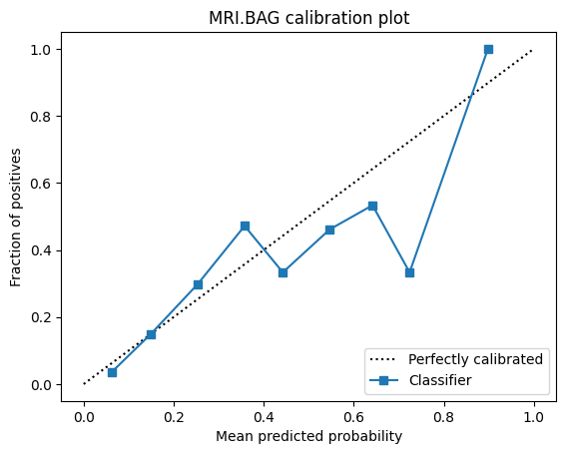
MRI BAG for cognitive outcome
460 subjects with full information. AUC: 0.7504469060351414, Sensitivity: 0.7075757575757576, Specificity: 0.6805042016806724 0 folds did not contain any positive class predictions.
Probability cutoffs for increased risk of cognitive deterioration, range:
[0.2439613526570048, 0.24637681159420288].
Mean: 0.24565217391304345, median: 0.24637681159420288

Slide 26
THRESHOLD FOR DELCODE
68 subjects with full information. AUC with mean probabilities: 0.760989010989011 Sensitivity: 0.6923076923076923, Specificity: 0.6428571428571429

